Slide 2

Research Thesis Title Word Embeddings on Songs Metadata for Genre Recommendation
Supervised By :
Prof. Paolo Ceravalo
Dr. Samira Maghool
Prepared by :
Shripad Ambure (942364)

Slide 3
Contents
Introduction
Deep Learning and NLP
Word embeddings
Clustering Techniques
Results and Discussion
Conclusion and Future Scope

Slide 4

Introduction
Music genre classification and grouping has become an increasingly important topic in recent years.
This Motivated me to push for Research into Relevant algorithms and work with genres of the Spotify songs data.
The Naive Bayes or k-Nearest Neighbors algorithms have often been used in the most effective algorithms.
But in my Research, I have been using clustering For analyzing the results on genre classification using RNN.
The purpose of this thesis is to study the usage of unsupervised clustering algorithms such as K-Means and to determine their utility in contrast to or in conjunction with existing approaches.

Slide 5
Spotify Data
More than 18000 Spotify songs are included in this dataset.
Together with information on the artist, album, audio features, lyrics, the language of the lyrics, genres, and subgenres.
The size of Dataset is 44.1mb.
The original Dataset was used in the 3rd week of the Tidy Tuesday Project(Podcast community).
Its open-Source dataset on Kaggle for research-oriented work.

Slide 6

Our Thesis approach
Combining Genres, Lyrics and Languages
Performing vectors
NLP Tasks to Analyse vectors
Cluster analysis
Distance between Genres and sub genres
Recommending Songs

Slide 7

NLP and Word Embeddings
Fortunately, Art is a strongly subjective matter. But humans are always trying to categorize everything. That's probably why we find Deep learning so appealing.
This Research brings a measure of word diversity in a document, applied to song Genres, lyrics and Languages.
Clustering the embedding space of words to determine the diversity of songs based on Genres.
We apply NLP approaches for text categorization
Tokenizing the words

Slide 8
Word embeddings
A technique to run WORDS Into NUMBERS (VECTORS)
Types of Word Embeddings : Frequency based : 1)count vector
2)TF-IDF Vector
Prediction based : 1)BOW (Bag of words)
2)SKIP gram
But in our thesis work we are working with distributed bag of words (D-bow) model. Because according to Google code archive it trains faster and able to capture the frequent songs more.

Slide 9
Word embeddings (document)
The goal of Word2Vec is to bring together in vector space the generated vectors of document that are similar in meaning.
Without assistance of anyone Word2Vec can create remarkably accurate assumptions about words based on occurrences in data.
Another way to think of document embedding is continuous calculation of word embeddings.
In our work I am using Gensim library to vectorize the words and tokenize them into vectors.
So Gensim is text processing package and this library makes use of unsupervised learning methods and mostly used in NLP.

Slide 10
Modelling
Distributed Bag of words (DBOW) is similar to Skip Gram variant of word2vec.
It helps in guessing the context words from target words.
While skip gram uses target words as input whereas dbow model includes paragraph ID as input.
Here is why I am applying DBOW Model to categorize each sentences to token using sent_tokenize method.

Slide 11
Clustering Techniques
Clustering is the classification algorithm to categorize the groups according to the similarity.
Hypothesis : if there are 1020 genres represented, would be each in the same cluster?
Hence, here I use K means clustering technique which is most popular in clustering algo. This fetches the genre to some specified datapoint.
Our Thesis work utilizes genre analysis in which data point are generated by the vectors.
Elbow method is most used unsupervised learning method to know the size of the clusters.
we are computing with WCSS for each k value to find out the distance between each datapoint in clusters.

Slide 12
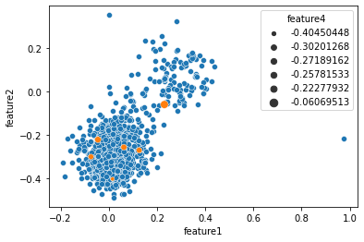
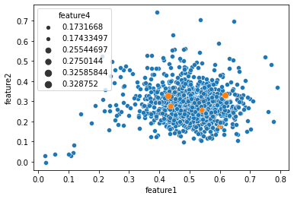
Results

Slide 13
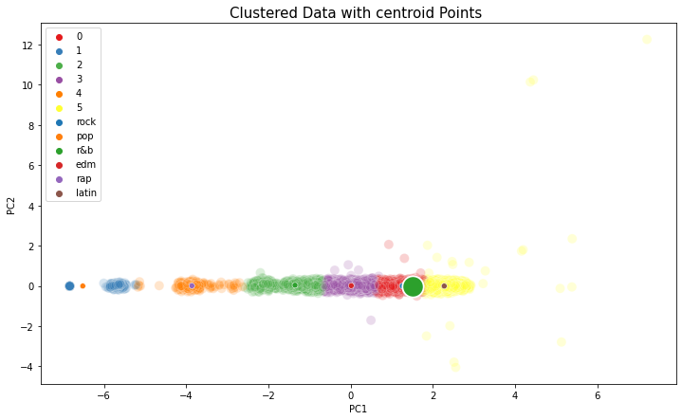
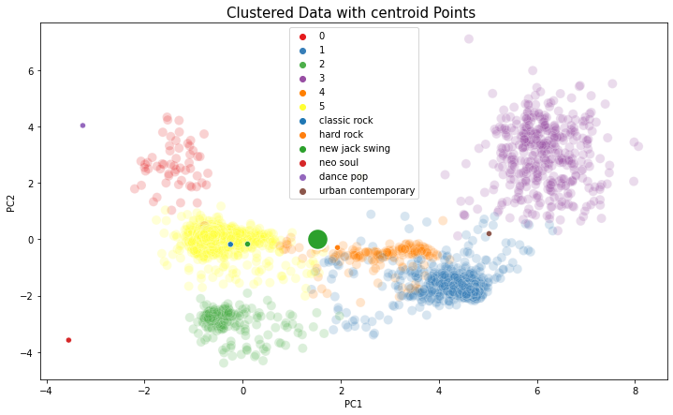
Results

Slide 14
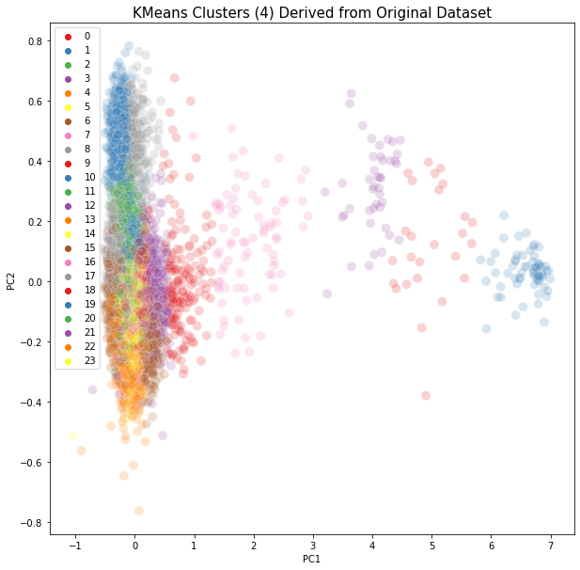
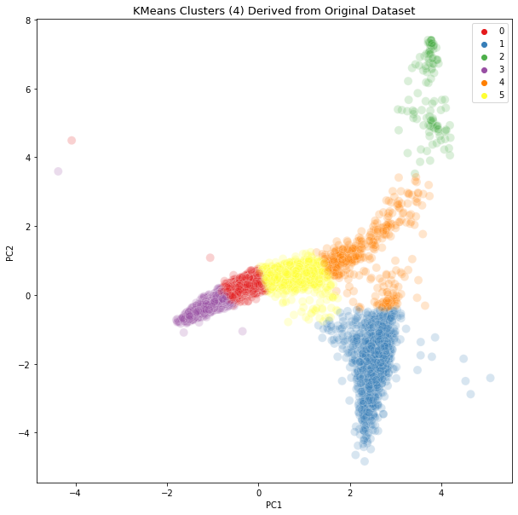
Results

Slide 15
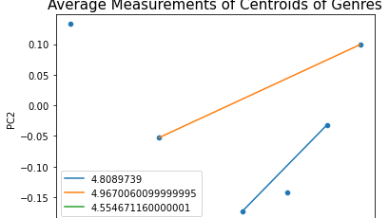
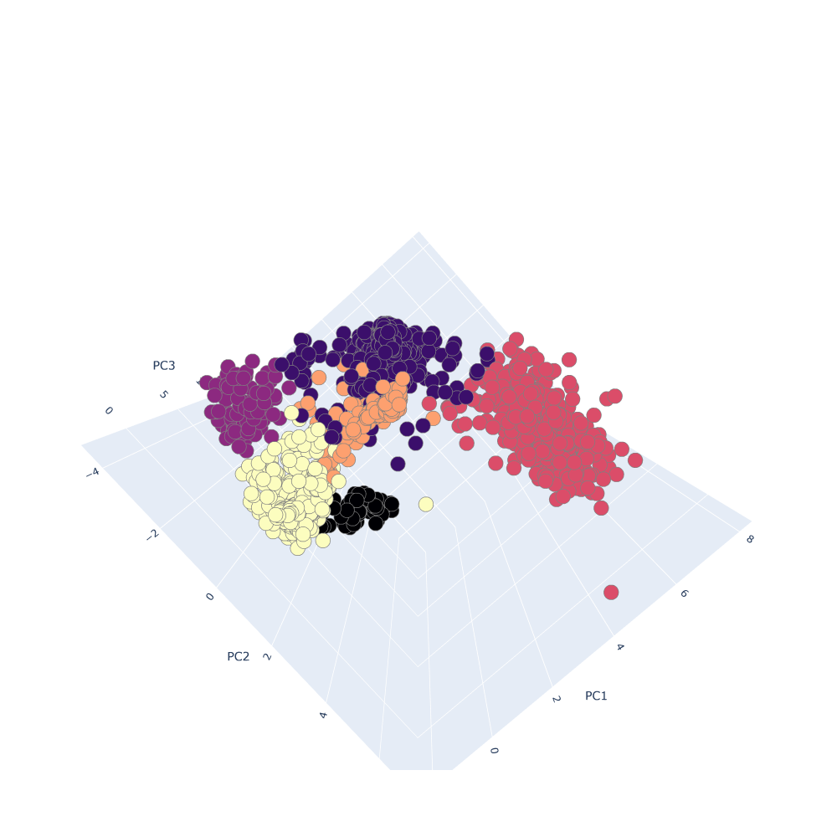
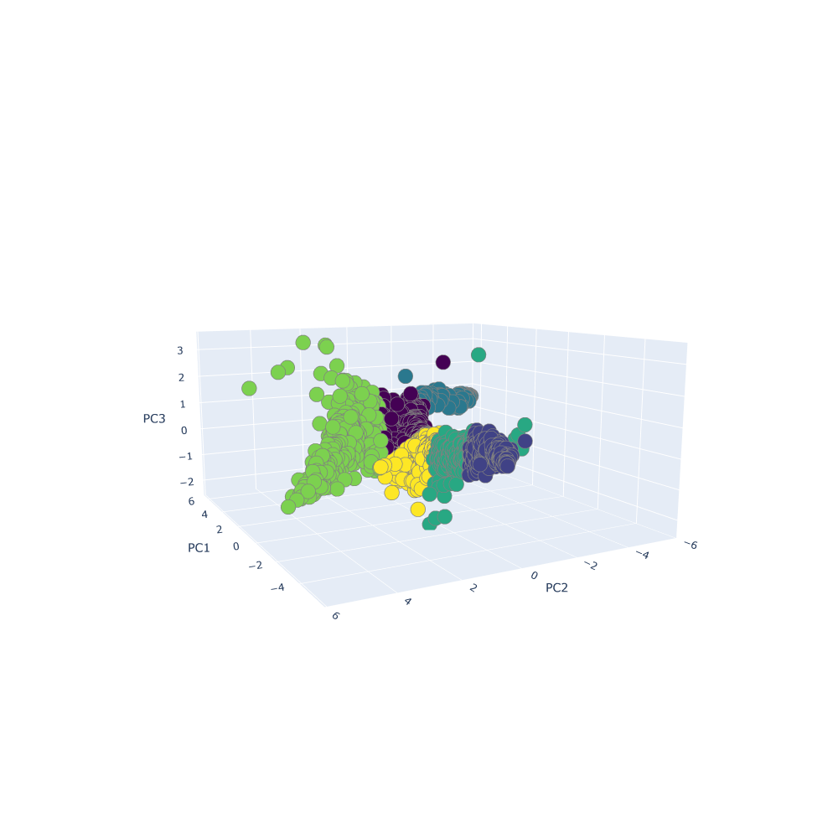
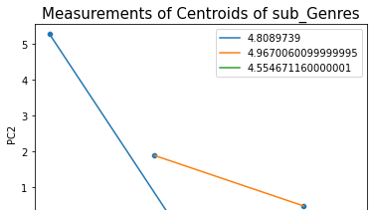
Results

Slide 16
Conclusion and Future Scope
Music Recommendation engine : once the model understands what every user likes then it can build a set of similar users and recommend songs that similar users would prefer to listen .
Song Identifier : We can create an playlist in Spotify or other music platform that can Have Similar music based on Genres and languages.

Slide 17


Thank You

